Slide 1
Building Resilient Vulnerability Management Program
Dhungel, Ravi
Staff Design Quality Cyber Security Engineer
Practitioners Approach
Advancing the world of health

Slide 2
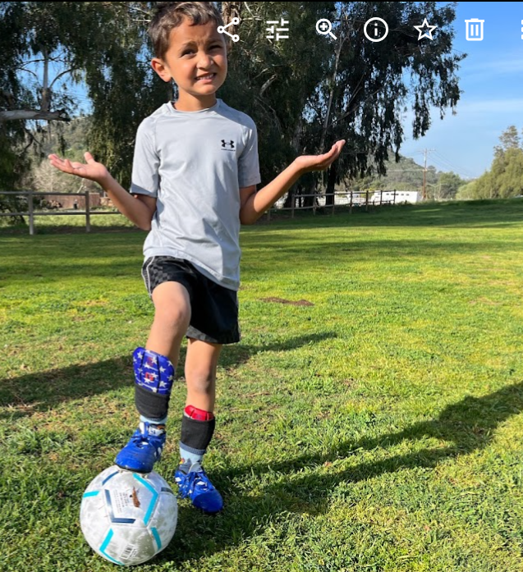

About Me
Born and raised in Himalayas, Nepal
Moved to the United States for Graduate school
M.S. in computer science and geographic information science (SIUC – dual major)
20+ years experience in Linux system engineering and cyber security
Industry Worked – Nepalese Army, ServiceNow, Intuit, USD, Ericsson etc
Country lived – Nepal, China (2006/2007), USA
Love outdoors | Hiking|Soccer
Mt. Whitney -14,505 ft
Everest Base Camp -17,598 ft
Kalapathar -18,519 ft
Mt. Kilimanjaro – 19341 ft
Mt Aconugua (Dec 2025) -22841
Advancing world of health

Slide 3
Agendas
Vulnerability: A vulnerability is a weakness in an information system, system security procedures, internal controls, human behavior, or implementation that could be exploited by a threat. – NIST 800-30
FDA cybersecurity guidance's on pre-market and post-market
Essentials of Vulnerability Management Program
People, Process and Technology
Vulnerability Life Cycle
Risk based approach for vulnerability management*
Third Party Vulnerability and patching
Design Controls
Cost of Vulnerability
Fundamental differences of post-market and pre-market VM programs
Impacts on downstream and upstream processes
Advancing world of health

Slide 4
FDA cyber guidance (pre market)
Secure Product Development Framework (SPDF)
Designing for Security
Transparency (labeling and coordinated vulnerability disclosure)
Threat Modeling
Cybersecurity Risk Assessment
Interoperability Considerations
Third-Party Software Components
Security Assessment of Unresolved Anomalies
TPLC Security Risk Management
Security Architecture Views
Cybersecurity Testing
Cybersecurity Management Plans
Design Controls deliverables
Advancing world of health

Slide 5
FDA cyber guidance (post market)
Total Product Life Cycle
Maintaining safety and essential performance
Medical device cybersecurity risk management (security + safety)
Assessing exploitability of the cybersecurity vulnerability and assessing severity of patient harm
Continuous Monitoring (Participation in ISAC programs)
Coordinated Vulnerability Disclosure Program
Reporting requirements and Recalls (Death or Serious Injury)
31(vulnerability) - premarket 125 (vulnerability) -postmarket
Advancing world of health

Slide 6
Essentials of VM program
Assessment: Identify and evaluate vulnerabilities in medical devices. This includes conducting risk assessments and penetration testing to uncover potential security gaps.
Prioritization: Prioritize vulnerabilities based on their potential impact on patient safety, device functionality, and data integrity. Critical vulnerabilities that could lead to severe consequences are addressed first.
Action: Implement measures to mitigate identified vulnerabilities. This can involve applying software patches, updating firmware, changing configurations, and enhancing security protocols.
Reassessment: After completing remediation, reassess the devices to ensure vulnerabilities have been effectively addressed and no new issues have been introduced. Continuous monitoring is essential.
Improvement: Analyze the entire process to identify areas for improvement. Includes refining assessment tools, updating processes, analyzing security metrics to better manage vulnerabilities in the future.
Advancing the world of health

Slide 7
Sources of Vulnerability
Customer Complain
Vulnerability scanning
Static Code Scanning
Threat Intel Feed H-ISAC
Security Researcher
Third Party Library
Security Architecture
Audit / CAPA
Penetration Testing
Threat Modeling
Advancing world of health

Slide 8
Vulnerability Impacts
Coordinated Disclosure
Traceability
FDA Security Metrics
510(k) Requirements
Cyber Risk Management
Field Action / Recalls
Safety and Essential performance

Slide 9
510(K) cyber security deliverables
9.1 Security Risk Management Report
9.2 Threat Model
9.3 Cybersecurity Risk Assessment
9.4 Software Bill of Materials (SBOM)
9.5 Cyber Unresolved Software Anomalies
9.6 Cyber Metrics
9.7 Cyber Controls ( Traceability )
9.8 Cyber Architectural Views
9.9 Cyber Testing
9.10 Cyber Labeling
9.11 Cyber Management Plan

Slide 10
Risk Management of Vulnerabilities
Challenges on onboarding vulnerabilities ( Core product, third party library/modules ) , scattered across different teams (complex product)
Centralized vulnerability management Is the most
Decreasing on-boarding processing time of vulnerabilities
Prioritizing the vulnerabilities on the basis of Risk
Vulnerabilities based on impact and likelihood + focus on exploitability + (Safety)
Scoring Framework – specific to the product, team, consistency is the most.
Ex- Risk score = > NIST800-30 – Likelihood [ Discoverability, Exploitability, Reproducibility – borrowed from Microsoft DREAD framework] X Impact [ Individual , Organization, Operations, Assets ] - Singaporean Model
Ex- **CVSS Score + Exploitability (CVSS score is vulnerability score not a risk score)
**Not a standard score
Advancing world of health

Slide 11
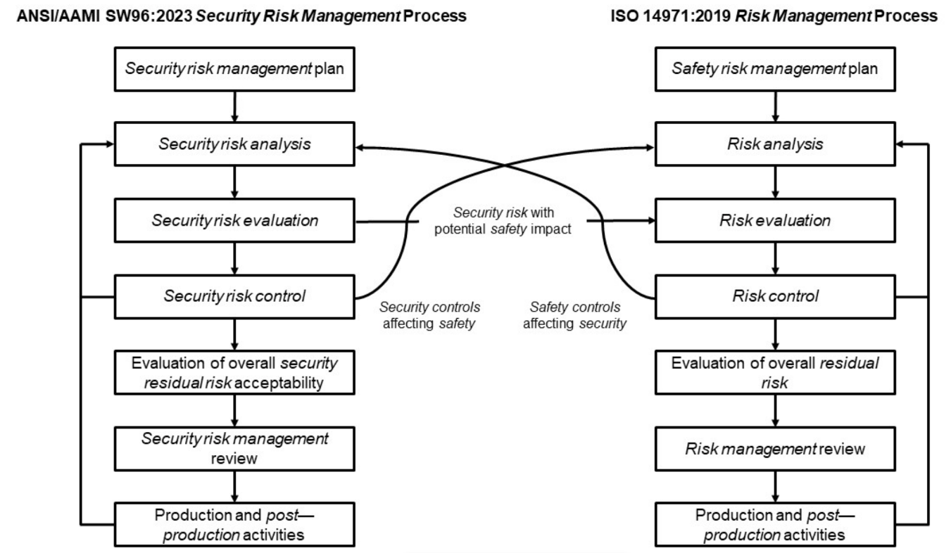
Cyber Risk Versus Risk Management Process
9.1 Security Risk Management Report
No scoring frameworks are perfect
Challenges on performing security
risk assessment versus safety risk
Assessment. Non Prob Vs. Prob.
Engaging risk management team
and medical/clinical affairs team early
in the discussion
ANSI/AAMI SW96:2023 Standard for
medical device security – security
risk management for device
manufacturers
Advancing world of health

Slide 12
Mitigation Strategies
9.1 Security Risk Management Report
- Moving security to the left //DevSecOps movement www.devsecops.org
-Secure Product Development Life Cycle (SPDLC)
-Secure CICD process
-Secure key/certificate management management etc.
-Threat Modeling
-Architectural Diagrams
-Static/Dynamic Scanning
-secure configuration and hardening
- Implementing patches and updates – process in place, legacy takes many days and months.
- Network segmentation and isolation ( Helps to contain the environment in the incidence)
Advancing world of health

Slide 13
Monitoring and Detection
Continuous Monitoring (Pre-market and Post-market environments)
Threat Intel platforms (H-ISAC, VirusTotal, CISA etc)
Vulnerability Scanning
Static Scanning
SBOM Tools
Third Party Monitoring
Customer Feedback
Situational Analysis
Governance Report
Severity of the Vulnerability ( zero-day, third party etc.)
Regulatory requirements
FDA metrics ( helps in trending of the vulnerabilities )

Slide 14
FDA Security Metrics
Percentage of identified vulnerabilities that are updated or patched (defect density);
(OTS/ Third party will skew this metric)
Duration from vulnerability identification to when it is updated or patched; and
( Many deferral including third party will skew this metric)
Duration from when an update or patch is available to complete implementation in devices deployed in the field, to the extent known.
( Challenge to the legacy products that has multiple versions and need to patch manually in the field )

Slide 15
Life Cycle of Vulnerability
Sources of vulnerabilities
Cyber Issues post/premarket
Cyber Risk Assessment
Disposition
Fix
Verification
Pen testing
Dynamic / Static Scanning etc.
Continuous
monitoring
Vulnerability intake process
Fix Review
Close
Security risk assessment (scoring)
Rejection
Deferral
Fix
Security controls
Cyber Labeling
Timeline / Priority (PM)
Vulnerability Disclosure
Cyber Metrics
Safety Risk Assessment
Situational Analysis Field Action
Security Architecture
Coordinated Vulnerability Disclosure
DRA – Hazard ID
Threat Modeling
Advancing world of health

Slide 16
Robust Design Controls
Design Input
(user needs, security requirements , Threat modeling)
Design Review
(R1, R2, R3, R4)
Design History File
Design Output
(security architecture, security controls, security test plans)
Design Transfer
Design Master Record
Design Verification
(code reviews, security testing, pen testing, compliance check)
Risk Management
Design Validation
(User Acceptance Testing, security audits, continuous monitoring)
Advancing world of health

Slide 17
Vulnerability Management
Postmarket Vulnerability Management
Focus: Addresses cybersecurity after the device has been marketed and is in use.
Objective: Ensures ongoing monitoring and management of cybersecurity risks throughout the device's lifecycle.
Key Activities:
Monitoring: Continuously monitoring for new vulnerabilities and threats.
Updates: Implementing security patches and updates to address identified vulnerabilities.
Incident Response / Cyber Risk Assessment: Developing and executing plans to respond to cybersecurity incidents.
Outcome: Aims to maintain device security and protect patient safety by addressing vulnerabilities as they arise.
Premarket Vulnerability Management
Focus: Addresses cybersecurity during the design, development, and pre-approval stages of medical devices.
Objective: Ensures that devices are designed with robust cybersecurity measures before they are marketed.
Key Activities:
Risk Analysis: Identifying potential cybersecurity risks and vulnerabilities during the design phase.
Documentation: Including cybersecurity considerations in premarket submissions, such as device design, labeling, and risk management plans
Testing: Conducting cybersecurity testing to validate the effectiveness of security controls.
Outcome: Aims to prevent vulnerabilities from being introduced into the market by ensuring devices are secure from the outset.
Advancing world of health

Slide 18
Post Market – Vulnerability Management
9.1 Security Risk Management Report
Fixing vulnerabilities in the post-market environment is significantly more expensive than addressing them during the design controls or pre-market phase.
Cost Multiplication: Studies suggest that the cost of fixing a vulnerability increases exponentially as it moves through the product lifecycle. For example:
During the design phase, fixing a vulnerability might cost 1x.
In the pre-market phase (e.g., during testing), it could cost 10x.
In the post-market phase, it might escalate to 100x or more due to recalls, patches, and regulatory penalties.
Regulatory and Legal Costs: In the medical device industry, post-market fixes often involve notifying regulatory bodies like the FDA, issuing recalls, and updating devices already in use.
Reputation Damage: Beyond direct costs, post-market vulnerabilities can harm a company's reputation, leading to lost sales and trust.
Operational Disruption: Fixing vulnerabilities post-market may require halting production, deploying field engineers, or issuing software updates, all of which are resource-intensive.
Advancing world of health

Slide 19
Conclusion
Enhanced Patient Safety: Addressing vulnerabilities helps prevent unauthorized access and manipulation of medical devices, ensuring they function correctly and safely. This reduces the risk of harm to patients
Data Security and Privacy: Medical devices often store and transmit sensitive patient data. Fixing vulnerabilities helps protect this data from breaches and unauthorized access, maintaining patient confidentiality and trust
Compliance with Regulations: Healthcare providers and manufacturers must adhere to strict regulatory standards. Fixing vulnerabilities ensures compliance with these regulations, avoiding legal penalties and maintaining industry standards
Improved Device Reliability: By addressing vulnerabilities, manufacturers can enhance the overall reliability and performance of medical devices, leading to better patient outcomes and more efficient healthcare delivery
Reputation Management: Ensuring medical devices are secure and reliable helps maintain the reputation of healthcare providers and manufacturers, fostering trust among patients and stakeholders
Advancing world of health

Slide 20
Thank you. Questions
Notes:
Note: To get the most recent copyright block and trademark byline, along with guidance on third-party trademarking, see the General Trademark Usage Guidelines on Maxwell.
https://maxwell.bd.com/sites/law-group/SitePage/228447/trademarks-and-copyrights

